Slide 1
What is Hive?
Hive is a Data Warehousing tool. Hive is used to query structured data built on top of Hadoop.
Facebook created Hive component to manage their ever-growing volume of data.

Slide 2
What is Hive ?
Apache Hive is a popular SQL interface for batch processing on Hadoop.
Hadoop was built to organize and store massive amounts of data.
Hive gives another way to access data inside the cluster in easy, quick way.
Hive makes use of the following :
HDFS for Storage
MapReduce for execution
Stores metadata in an RDBMS

Slide 3
Hive provides a query language called HiveQL that closely resembles the common Structured Query Language (SQL) standard.
Hive was one of the earliest project to bring higher-level languages to Apache Hadoop.
Hive gives ability to Analysts and Data Scientists to access data with out being expert in Java .
Hive gives structure to Data on HDFS making it data warehousing platform.

Slide 4
This interface to Hadoop
not only accelerates the time required to produce results from data analysis,
it significantly broadens who can use Hadoop and MapReduce.
Let us take a moment to thank Facebook team because
Hive was developed by the Facebook Data team and, after being used internally, it was contributed to the Apache Software Foundation .
Currently Hive is freely available as an open-source software from Apache.

Slide 5
What Hive is not?
Hive is not Relational Database, it uses a database to store meta data, but the data that hive processes is stored in HDFS.
Hive is not designed for on-line transaction processing(OLTP).
Hive is not suited for real-time queries and row level updates and it is best used for batch jobs over large sets of immutable data such as web logs.

Slide 6
Typical Use-Case of Hive
Hive takes large amount of unstructured data and place it into a structured view.
Hive supports use cases such as Ad-hoc queries, summarization, data analysis.
HIVEQL can also be exchange with custom scalar functions means user defined functions(UDF'S), aggregations(UDFA’s) and table functions(UDTF's)
It converts SQL queries into MapReduce jobs.

Slide 7
Features of Hive
It is similar to SQL.
HQL is easy to code.
Hive supports rich data types such as structs, lists, and maps.
Hive supports SQL filters, group-by and order-by clauses.

Slide 8
Prerequisites of Hive in Hadoop
The prerequisites for setting up Hive and running queries are
User should have stable build of Hadoop
Machine should have Java 1.6 installed
Basic Java Programming skills
Basic SQL Knowledge
Start all the services of Hadoop using the command $ start-all.sh.
Check all services are running, then use $ hive to start HIVE

Slide 9











Hive Integration and Workflow
Hourly Log data can be stored directly into HDFS
And then datacleaning is performed on the log file
Finally Hive Table can be created to query the log file.
Hourly Log
Hadoop HDFS Log Compression
Hive table 2
Hive Table 1

Slide 10
Hive Integration and Workflow
The workflow has 3 main stages :
Hourly Log Data Ingestion
Logs are generated every hour from different sources (e.g., web servers, applications) and directly stored in HDFS.
Data Cleaning & Compression
Data Cleaning
After storage in HDFS, log files may have inconsistencies, missing values, or redundant data.
Data cleaning involves removing errors, filtering unwanted data, and ensuring data integrity.
Log Compression
Since logs are usually large in volume, they are compressed to save storage space.

Slide 11
Hive Integration and Workflow
Hive Table Creation & Querying
Once logs are cleaned and compressed, they are stored in Hive tables for efficient querying.
Multiple Hive tables (Hive Table 1, Hive Table 2) can be created:
Hive Table 1: May store raw or minimally processed logs.
Hive Table 2: Could contain aggregated or transformed data for analytics.
Hive allows SQL-like queries on HDFS-stored data without needing complex MapReduce jobs.

Slide 12
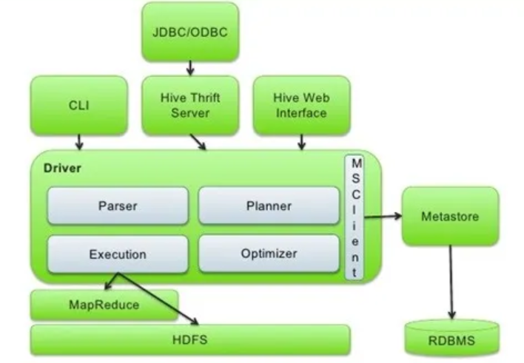
Hive Architecture

Slide 13
Hive Architecture
1. Interfaces :
Hive Command Line Interface (Hive CLI): Directly executes HiveQL queries in the terminal.
Hive Web Interface: A browser-based interface for submitting and managing queries.
Hive Thrift Server: Enables external applications to interact with Hive using JDBC/ODBC.

Slide 14
Hive Architecture
2. Driver (Query Processing) :
The driver is responsible for processing queries by interacting with different Hive components.
Subcomponents of driver are :
Parser: Parses the HiveQL query and checks for syntax errors.
Planner: Converts the query into an execution plan using metadata from the Metastore.
Optimizer: Optimizes the execution plan by reordering operations for better performance.
Execution Engine: Executes the query by coordinating with MapReduce, Tez, or Spark.

Slide 15
Hive Architecture
3. Metastore (Metadata Management) :
Stores metadata about tables, partitions, columns, and schemas.
Metadata is usually stored in an RDBMS (such as MySQL or PostgreSQL).
Hive queries rely on Metastore to fetch information about table structures.
4. Storage Layer:
Hive supports multiple storage backends such as:
HDFS (Hadoop Distributed File System): The primary storage layer where raw data is stored.
RDBMS: Sometimes used for storing small reference data or metadata.
5. Execution Framework :
MapReduce: Default execution engine for batch processing.
Spark: Faster alternatives to MapReduce for interactive querying and advanced analytics.

Slide 16
Hive Query Execution Flow
The user submits a query via CLI, Thrift, or Web Interface.
The driver parses, plans, and optimizes the query.
The Metastore provides metadata for query execution.
The execution engine converts the query into MapReduce/Spark jobs.
The query is executed, and results are fetched from HDFS or RDBMS.
The final output is returned to the user.

Slide 17
Types of Metastores
1. Embedded Metastore:
Architecture:
The Hive service JVM (Java Virtual Machine) contains both the Driver and the Metastore.
It uses the Derby database for metadata storage.
Features:
The Metastore runs in the same JVM as Hive.
Best suited for testing and development environments.
Not scalable for production use.
Limitations:
Only one Hive session can access the Metastore at a time.
Causes locking issues when multiple sessions try to query metadata.

Slide 18
Types of Metastores
2. Local Metastore:
Architecture:
Each Hive service JVM has its own Metastore, which connects to an external database (MySQL, PostgreSQL, etc.).
Features:
Multiple Hive sessions can access metadata independently.
Faster than Embedded Metastore since it uses a separate RDBMS for storage.
Better suited for small production setups.
Limitations:
Still not highly scalable, as each Hive instance maintains its own Metastore instance.

Slide 19
Types of Metastores
3. Remote Metastore:
Architecture:
The Metastore runs in a separate JVM (Metastore server).
Multiple Hive service JVMs interact with the centralized Metastore server using Thrift API.
The Metastore server connects to an RDBMS (like MySQL, PostgreSQL, etc.).
Features:
Supports multiple Hive instances querying metadata concurrently.
Highly scalable and suitable for large-scale production environments.
Allows external tools (like Spark, Impala) to access metadata.
Limitations:
Requires additional setup and maintenance.

Slide 20
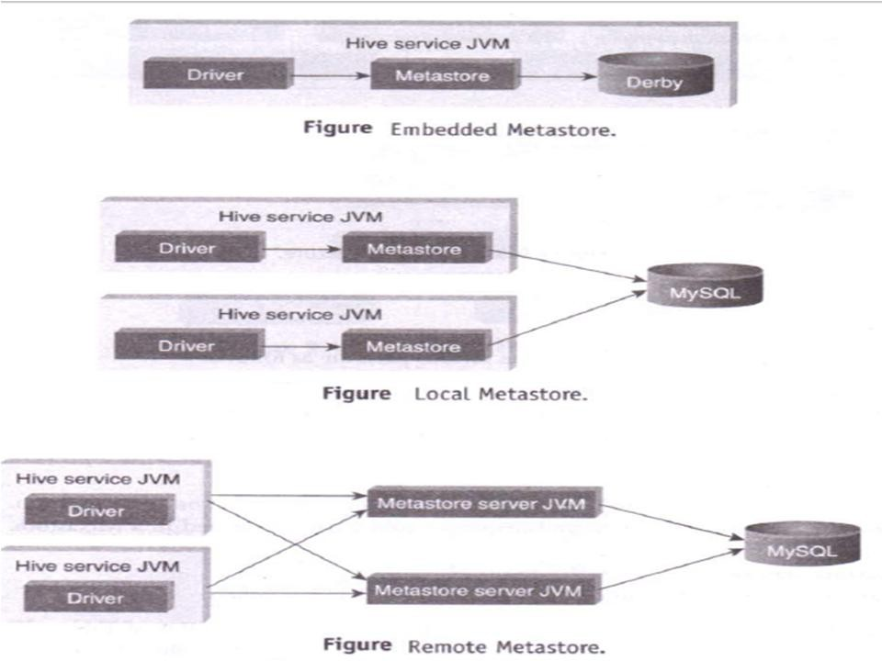

Slide 21
Hive Data Units
Data in Hive is organized into:
Database: Namespaces function
Tables - A relation table
Partitions - Data in each table may be divided into Partitions.
Buckets - Data in each partition may be divided into Buckets (or cluster)

Slide 22
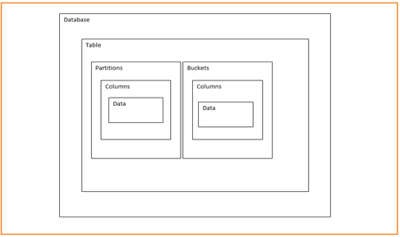
Hive Data Units

Slide 23

Database
A logical namespace in Hive that organizes related tables.
Similar to a schema in RDBMS.
Usually we have shared Hadoop/Hive cluster amongst multiple teams in regular production environment.
It is very important for us to segregate our work from other teams.
So, it is important to create our own database while working on Hive.

Slide 24
Tables
A table is an organized set of records which have same schema. An example of a table could be page_views table, where each row could comprise of the following columns (schema):
Tables
timestamp - A column which gives the time some has browsed the URL
userid - A unique identification of user
page_url - A string which consists of host name port and page visited.

Slide 25

Tables
Tables
Analogous to relational tables.
Hive tables resemble relational database tables, but they are schema-on-read, meaning data is stored in raw format and structured at query time.
Each table has a corresponding directory in HDFS.
Every Hive table is stored in HDFS under a specific directory, typically /user/hive/warehouse/dbname.db/tablename/
Each table’s data is stored as files inside this directory.
Data serialized and stored as files within that directory.
Hive serializes data into HDFS files using various formats (Text, ORC, Parquet, Avro, etc.).
The storage format is specified as :

Slide 26
Tables
Hive has default serialization built in which supports compression and lazy deserialization.
Hive supports compression (e.g., Snappy, Gzip, Bzip2) for reducing storage size.
Lazy deserialization means Hive only reads the required columns, optimizing query performance.
Users can specify custom serialization–deserialization schemes (SerDe’s).
Hive allows custom SerDe (Serialization-Deserialization) mechanisms to handle different file formats.

Slide 27
Tables
To load data into the table from file named student.tsv.
LOAD DATA LOCAL INPATH ‘/root/hivedemos/student.tsv' OVERWRITE INTO TABLE EXT_STUDENT;
To retrieve the student details from “EXT_STUDENT” table.
SELECT * from EXT_STUDENT;

Slide 28
Table ALTER Operations
ALTER TABLE mytablename RENAME to mt;
ALTER TABLE mytable ADD COLOUMNS (mycol STRING);
ALTER TABLE name RENAME TO new_name
ALTER TABLE name DROP [COLUMN] column_name
ALTER TABLE name CHANGE column_name new_name new_type
ALTER TABLE name REPLACE COLUMNS (col_spec[, col_spec ...])

Slide 29
Partitions
Partitions are nothing with logical segregation of data which classifies the given information based on certain attribute.
Each table can have one or more partitions which determines how the data is stored.
The benefit of doing so is to restrict the query to process only that data which is required.

Slide 30
Partitions
Partitions
Each table can be broken into partitions
Partitions determine distribution of data within subdirectories
Example -
CREATE TABLE Sales (sale_id INT, amount FLOAT)
PARTITIONED BY (country STRING, year INT, month INT)
So each partition will be split out into different folders like
Sales/country=US/year=2012/month=12

Slide 31































Hierarchy of Hive Partitions
File
File
File

Slide 32
Partition
The general definition of Partition is horizontally dividing the data into number of slices in an equal and manageable manner.
Every partition is stored as directory within data warehouse table.
In data warehouse this partition concept is common but there is two types of partitions are available in data warehouse concepts.
There are
SQL Partition
Hive Partition

Slide 33
Hive Partition
The main work of Hive partition is also same as SQL Partition but
– the main difference between SQL partition and hive partition is SQL partition is only supported for single column in table but in Hive partition it is supported for multiple columns in a table .

Slide 34
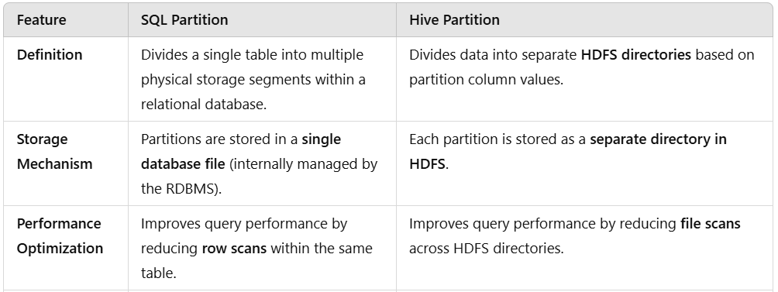
SQL vs Hive Partition

Slide 35
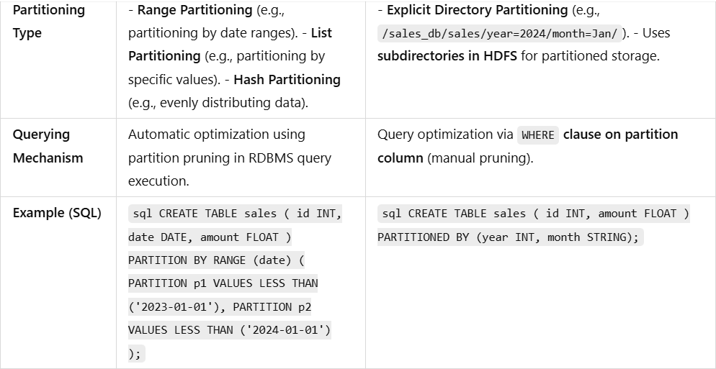
SQL vs Hive Partition

Slide 36
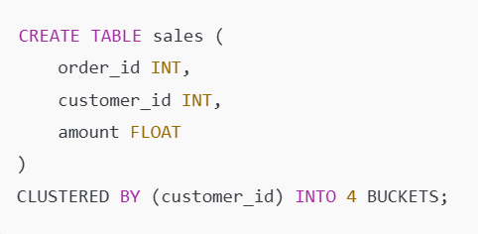
Buckets (or Clusters)
A technique that divides data into fixed-sized files (buckets) within a table or partition using a hashing function.
It helps optimize query performance, especially for joins and sampling.
Partitioning and bucketing are optional activates just to improve performance and making data more manageable.
This will divide the data into 4 buckets based on customer_id. Data is stored in 4 separate files inside the table directory.

Slide 37
Buckets (or Clusters)
Buckets
Data in each partition divided into buckets
Based on a hash function of the column
H(column) mod NumBuckets = bucket number
Each bucket is stored as a file in partition directory

Slide 38
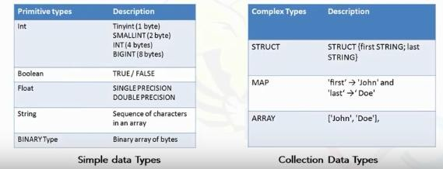
Hive Data Types

Slide 39
Hive Data Types
Numeric Data Type
TINYINT | 1 - byte signed integer
SMALLINT | 2 -byte signed integer
INT | 4 - byte signed integer
BIGINT | 8 - byte signed integer
FLOAT | 4 - byte single-precision floating-point
DOUBLE | 8 - byte double-precision floating-point number
String Types
STRING
VARCHAR | Only available starting with Hive 0.12.0
CHAR | Only available starting with Hive 0.13.0
Strings can be expressed in either single quotes (‘) or double quotes (“)
Miscellaneous Types
BOOLEAN
BINARY | Only available starting with Hive

Slide 40
Hive Data Types cont..
Collection Data Types
STRUCT | Similar to ‘C’ struct. Fields are accessed using dot notation. E.g.: struct('John', 'Doe')
MAP | A collection of key - value pairs. Fields are accessed using [] notation. E.g.: map('first', 'John', 'last', 'Doe')
ARRAY | Ordered sequence of same types. Fields are accessed using array index. E.g.: array('John', 'Doe')

Slide 41
Hive File Format
Text File: The default file format is text file.
Sequential File: Sequential files are flat files that store binary key-value pairs.
RCFile (Record Columnar File):
RCFile stores the data in Column Oriented Manner which ensures that Aggregation operation is not an expensive operation.

Slide 42
Hive Query Language (HQL)
Works on
(Clusters)
Create and manage tables and partitions.
Databases, Tables, Partitions, Buckets
Support various Relational, Arithmetic, and Logical
Operators.
Evaluate functions.
Downloads the contents of a table to a local directory or result of queries to HDFS directory.

Slide 43
HQL Command to create Database
To create a database named “STUDENTS” with comments and database properties.
CREATE DATABASE IF NOT EXISTS STUDENTS COMMENT 'STUDENT
Details' WITH DBPROPERTIES ('creator'
= 'JOHN');

Slide 44
HQL Command to describe a Database
To describe a database
DESCRIBE DATABASE STUDENTS;
To show Databases
SHOW DATABASES;
To drop database.
DROP DATABASE STUDENTS;

Slide 45
Hive Commands
Data Definition Language (DDL )
DDL statements are used to build and modify the tables and other objects in the database.
Example :
CREATE, DROP, TRUNCATE, ALTER, SHOW, DESCRIBE Statements.
Go to Hive shell by giving the command sudo hive and enter the
command ‘create database<databasename>’ to create the new database in the Hive.

Slide 46

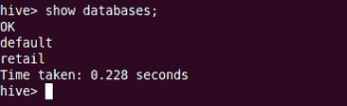
To list out the databases in Hive warehouse, enter the command ‘show databases’.

Slide 47


The command to use the database is USE
<data base name>
Copy the input data to HDFS from local by using the copy From Local command.

Slide 48
Tables
There are two types of tables in Hive:
–Managed table
–External table
The difference between two is when you drop a table:
– if it is managed table hive deletes both data and meta data,
–if it is external table hive only deletes metadata.
Use external keyword to create a external table

Slide 49
Tables
To create managed table named ‘STUDENT’.
CREATE TABLE IF NOT EXISTS
STUDENT(rollno
INT,name FLOAT) ROW FORMAT
STRING,gpa DELIMITED
FIELDS TERMINATED BY '\t';

Slide 50
Tables
To create external ‘EXT_STUDENT’.
table
named
CREATE EXTERNAL EXISTS
TABLE IF NOT
EXT_STUDENT(rollno
INT,name FORMAT
STRING,gpa FLOAT) ROW
DELIMITED FIELDS TERMINATED BY '\t' LOCATION ‘/STUDENT_INFO;

Slide 51
Tables
To load data into the table from file named student.tsv.
LOAD DATA LOCAL INPATH
‘/root/hivedemos/student.tsv' OVERWRITE INTO TABLE EXT_STUDENT;
To retrieve the student details “EXT_STUDENT” table.
SELECT * from EXT_STUDENT;
from

Slide 52
Table ALTER Operations
ALTER TABLE mytablename RENAME to mt;
ALTER TABLE mytable ADD COLOUMNS (mycol STRING);
ALTER TABLE name RENAME TO new_name
ALTER TABLE name DROP [COLUMN] column_name
ALTER TABLE name CHANGE column_name new_name new_type
ALTER TABLE name REPLACE COLUMNS (col_spec[, col_spec ...])

Slide 53
When we create a table in hive, it creates in the default location of the hive warehouse.
“/user/hive/warehouse”, after creation of the table we can move the data from HDFS to hive table.
The following command creates a table with in location of “/user/hive/warehouse/retail.db”
Note : retail.db is the database created in the Hive warehouse.

Slide 54
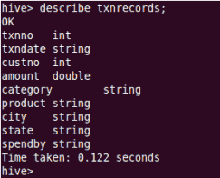
Describe provides information about the schema of the table.

Slide 55
Data Manipulation Language (DML )
DML statements are used to retrieve, store, modify, delete, insert and update data in the database.
Example :
LOAD, INSERT Statements.

Slide 56
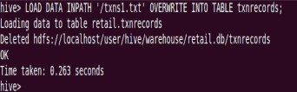
Syntax :
LOAD data <LOCAL> inpath <file path> into table
[tablename]
The Load operation is used to move the data into corresponding Hive table.
If the keyword local is specified, then in the load command will give the local file system path.
If the keyword local is not specified we have to use the HDFS path of the file.

Slide 57
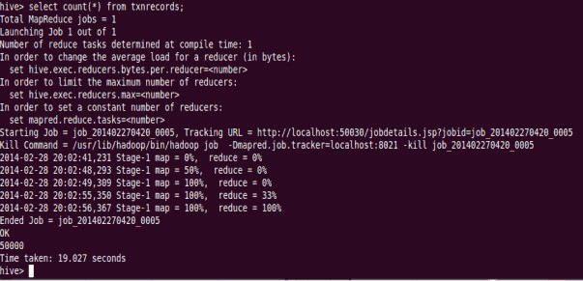
Data Manipulation Statements or aggregate functions retrieve the data.
Example to count number of records:
– Count aggregate function is used count the total number of the records in a table.

Slide 58

Create External Table
The create external keyword is used to create a table and provides a location where the table will create, so that Hive does not use a default location for this table.
An EXTERNAL table points to any HDFS location for its storage, rather than default storage.

Slide 59
Insert Command
The insert command is used to load the data Hive table.
Inserts can be done to a table or a partition.
INSERT OVERWRITE is used to overwrite the existing data in the table or partition.
INSERT INTO is used to append the data into existing data in a table.

Slide 60
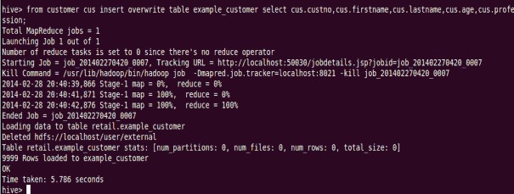

Slide 61
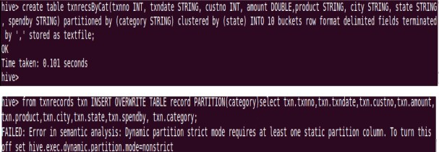
Partitioned By and Clustered By Command
‘Partitioned by‘ is used to divided the table into the Partition and
can be divided in to buckets by using the ‘Clustered By‘ command.

Slide 62

The ‘Drop Table’ statement deletes the data and metadata for a table.
In the case of external tables, only the metadata is deleted.

Slide 63
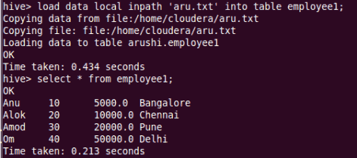
Load data local inpath ‘aru.txt’ into table tablename and then we check employee1 table by using Select * from table name command

Slide 64
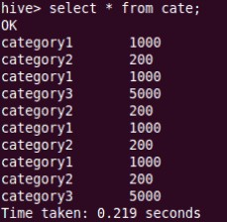
Aggregation
Select count (DISTINCT category) from tablename;
This command will count the different category of ‘cate’ table. Here there are 3 different categories.
Suppose there is another table cate where f1 is field name of category.

Slide 65
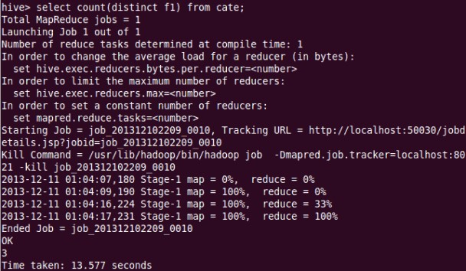
Aggregation

Slide 66
Grouping
Group command is used to group the result-set by one or more columns.
Select category, sum( amount) from txt records group by category
It calculates the amount of same category.

Slide 67
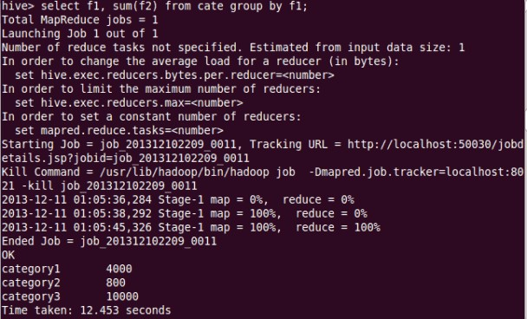
Grouping

Slide 68
Partitions
Partitions split the larger dataset into more meaningful chunks.
Hive provides two kinds of partitions: Static Partition and Dynamic
Partition.
To create static partition based on “gpa” column.
CREATE TABLE IF NOT EXISTS STATIC_PART_STUDENT (rollno INT, name STRING) PARTITIONED BY (gpa FLOAT) ROW FORMAT DELIMITED FIELDS TERMINATED BY '\t';
Load data into partition table from table.
INSERT OVERWRITE TABLE STATIC_PART_STUDENT
PARTITION (gpa =4.0) SELECT rollno, name from EXT_STUDENT where gpa=4.0;

Slide 69
Partitions
To create dynamic partition on column date.
CREATE TABLE IF NOT EXISTS DYNAMIC_PART_STUDENT(rollno INT, name STRING) PARTITIONED BY (gpa FLOAT) ROW FORMAT DELIMITED FIELDS TERMINATED BY '\t';
To load data into a dynamic partition table from table.
SET hive.exec.dynamic.partition = true;
SET hive.exec.dynamic.partition.mode = nonstrict;
Note: The dynamic partition strict mode requires at least one static partition column. To turn this off,
set hive.exec.dynamic.partition.mode=nonstrict
INSERT OVERWRITE TABLE DYNAMIC_PART_STUDENT
PARTITION (gpa) SELECT rollno,name,gpa from EXT_STUDENT;

Slide 70
Buckets
Tables or
partitions are sub-divided
into buckets, to provide extra structure to the data that may be used for more efficient querying. Bucketing works based on the value of hash function of some column of a table.
We can add partitions to a table by altering the table. Let us assume we have a table called employee with fields such as Id, Name, Salary, Designation, Dept, and yoj.

Slide 71
Buckets
To create a bucketed table having 3 buckets.
CREATE TABLE IF NOT EXISTS STUDENT_BUCKET (rollno
INT,name STRING,grade FLOAT)
CLUSTERED BY (grade) into 3 buckets;
Load data to bucketed table.
FROM STUDENT
INSERT OVERWRITE TABLE STUDENT_BUCKET
SELECT rollno,name,grade;
To display the content of first bucket.
SELECT DISTINCT GRADE FROM STUDENT_BUCKET TABLESAMPLE(BUCKET 1 OUT OF 3 ON GRADE);

Slide 72
Aggregations
Hive supports aggregation functions like avg, count, etc.
To write the average and count aggregation function.
SELECT avg(gpa) FROM STUDENT; SELECT count(*) FROM STUDENT;

Slide 73
Group by and Having
To write group by and having function.
SELECT rollno, name,gpa FROM STUDENT
GROUP BY rollno,name,gpa
HAVING gpa > 4.0;

Slide 74
SerDer
SerDe is a short name for "Serializer and Deserializer
Contains the logic to convert unstructured data into records.
Implemented using Java.
Serializers are used at the time of writing.
Deserializers are used at query time (SELECT Statement).
Hive uses SerDe (and FileFormat) to read and write table rows.
HDFS files --> InputFileFormat --> <key, value> --> Deserializer --> Row object
Row object --> Serializer --> <key, value> --> OutputFileFormat --> HDFS files

Slide 75
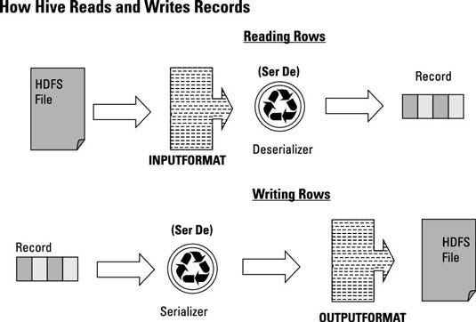

Slide 76
Serialization
Serialization is the process of converting a
data object a combination of code and data represented within a region of data storage
into a series of bytes that saves the state of the object in an easily transmittable form.
In this serialized form, the data can be delivered to another data store (such as an in-memory computing platform), application, or some other destination.

Slide 77
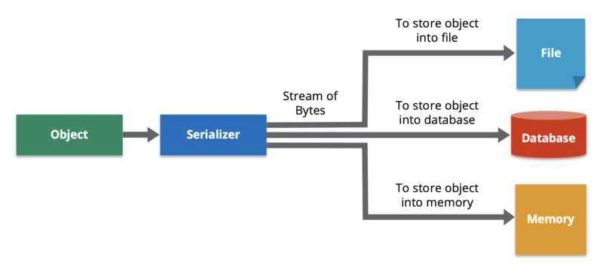

Slide 78
Deserialization
Deserialization is the process of reconstructing a data structure or object from a series of bytes or a string in order to instantiate the object for consumption.
This is the reverse process of serialization, i.e., converting a data structure or object into a series of bytes for storage or transmission across devices.
To fetch an object state over a wire or read it from persistent storage, a system must be able to deserialize it from raw bytes.

Slide 79
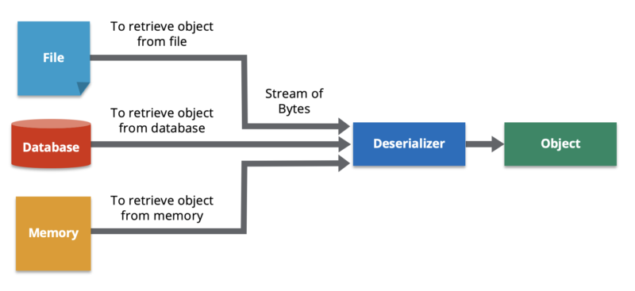
Deserialization

Slide 80
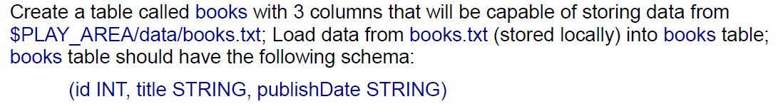
Exercise

Slide 81
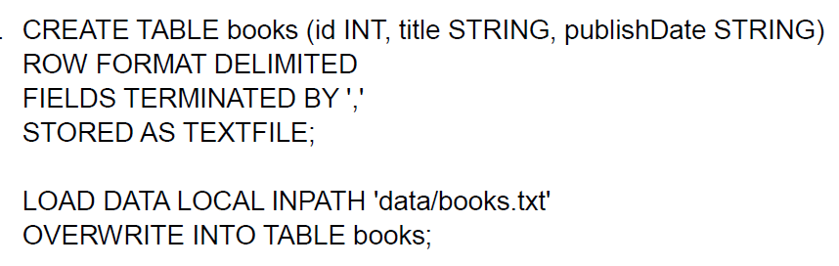

Slide 82
select record from books table with id of 2

Slide 83
select record from books table with id of 2
select * from books where id=2;

Slide 84
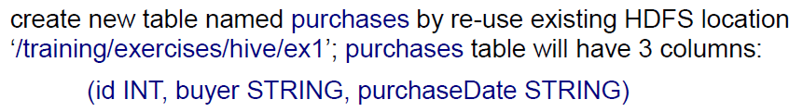

Slide 85
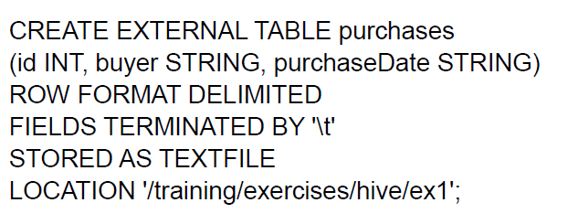

Slide 86
select 5 rows from purchases table

Slide 87
select 5 rows from purchases table
select * from purchases limit 5;

Slide 88
Fill in the blanks
The metastore consists of ______________ and a ______________.
The most commonly used interface to interact with Hive is ______________.
The default metastore for Hive is ______________.
Metastore contains ______________ of Hive tables.
______________ is responsible for compilation, optimization, and execution of Hive queries.

